Slide 1
Agenda for the day
9-10 IEA TEM proposal on Floating offshore array needs
10-11 DOE staff meeting
11-12 Review FY18 weight sensitivity study
12-1 Lunch
1-2 FY19 offshore systems work

Slide 2
FY18 Study Review
Floating Offshore Wind Turbine Substructure Design and Sensitivity to Tower Top Weight with a Hydrostatic-based Systems Design Tool

Slide 3
Executive Summary
Modeling Contribution
FloatingSE, with hydrostatic-focused analysis, is fully integrated into WISDEM
Generic geometry parameterization to describe many types of substructures
Design evaluation via application of codes and standards, hydrostatic principals, and simple static beam analysis
WISDEM can now simulate a full floating offshore wind turbine
Analysis Contribution
A spar, semisubmersible, and TLP for a 10MW turbine were designed via global optimization
Nacelle mass design sensitivity study was conducted
Mimics the weight reduction from a novel drivetrain or generator technology
Parameterized the mass reduction and re-optimized the substructure at every point
Break-even cost premium for the more expensive, but lighter-weight technology:
Spar: $0.25-0.75/kg Semi: $0.75-1.00/kg TLP: $0.1/kg
Observation: mass is poor surrogate for cost in global optimization studies

Slide 4
Outline
Motivation and Approach
Model Set-Up
Design Evaluation
Conceptual Design Optimization and Sensitivity Study
Conclusions

Slide 5
Outline
Motivation and Approach
Model Set-Up
Design Evaluation
Conceptual Design Optimization and Sensitivity Study
Conclusions
Motivation and Approach

Slide 6
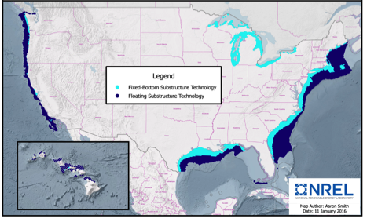
US has a tremendous offshore wind resource and most of it can only be accessed with floating wind technology
There is a tremendous wind resource located within 200nm of the US coastline
Much of this resource is in close proximity to high energy demand centers
58% of this resource is located over water depths >60m
Floating offshore turbine technology is the only pathway to tapping this resource at competitive costs
Great Lakes
Pacific
North
Atlantic

Slide 7
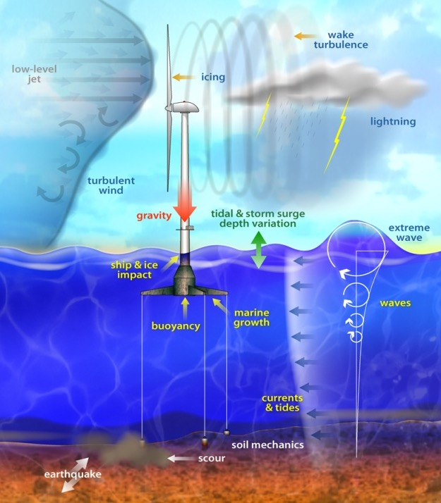
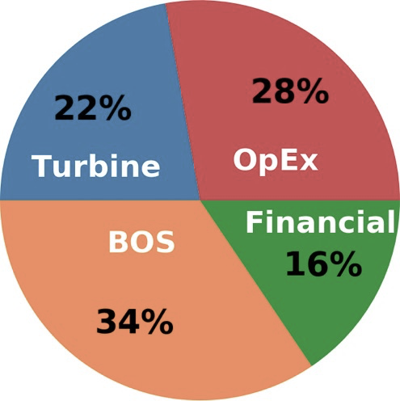
Physical and economic complexities make the floating challenge well- suited to system-focused solutions
Illustration by Al Hicks, NREL
Floating Wind LCOE Breakdown
Source: Mone et al. (2017)
78% of LCOE does not come from the turbine (but is impacted by its design)
*BOS: balance of station
There are many physical phenomena involved in floating wind energy and capturing all of the interactions is an extreme challenge.
Given the complexity of:
Physics – aerodynamic and hydrodynamic loading on a compliant structure
Logistics – manufacturing, operational expenditures (OpEx), installation, and assembly
Economics – over 50 types of costs are impacted.
A multidisciplinary, systems-focused approach is needed!
Notes:
Argue Iterative won’t cut it for floating
Physically extremely complex- wind/hydro loads difficult to predict or even measure accurately
Compliant structure that moves in 6 DOF
Engineers work so hard on good product, but TurbEx only 22% of lifetime cost LCOE
Additional complexity in logistics, BOS, O&M, economics that tie back to engineering design decisions
Really need a system approach to tackle whole balance sheet and maximize perf

Slide 8
MDAO allows for linking engineering design decisions to the LCOE balance sheet, but will require tool and expertise development
MDAO Framework
Union of all disciplines and costs into a single simulation framework
Enables optimization and tradespace exploration
MDAO Benefits and Output
Accelerates engineer’s exploration of the tradespace and discovery of hybrid innovations
Prior expertise is essential to achieve credible objectives
Optimization does not replace the engineer!
Floating Wind MDAO Tool Requirements
Integrated design: Design systems holistically, considering the turbine, tower, controller, and floater as one integrated system
Lifetime cost accounting: Consider cost impact of all factors including manufacturing, installation, operation, maintenance, and decommissioning.
Integrated paradigm: Multidisciplinary analysis and optimization (MDAO)
Notes:
So what does this look like?
Need MDAO Framework
Framework that has Integrated Design: all turbine engineering for power production from rotor through drivetrain, structural support, controller sits between them
Also full lifecycle costs: manufacturing, install, assembly, O&M, decommission
Benefits is accelerate exploration of tradespace: all design possibility
Does not replace engineer: experience is critical. No press button for magical innovation
TRANS: Let’s explore this a little more

Slide 9
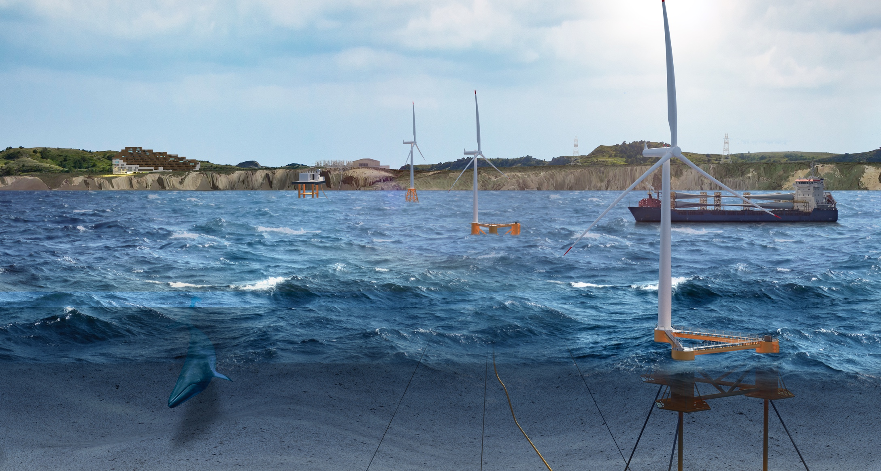
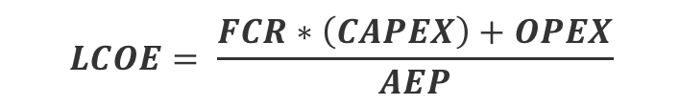
Optimization objective is LCOE, the full lifecycle cost of the whole plant, to (try to) capture the entire value chain
Capture the entire lifecycle cost in LCOE
CapEx is the capital expenditures (sum of balance-of-station and turbine capital cost)
OpEx are the annual operational expenditures
FCR is the fixed charge rate to annualize CapEx
AEP is the net annual energy production
LCOE isn’t perfect
Only captures costs, not revenue
Would like to capture the “value chain” for the developer.
Optimization
Objective
$$LCOE= \frac{FCR∗\left(CAPEX\right)+OPEX}{AEP}$$
Complex Wind Inflow
Analysis modules for LCOE calculation
Turbine Design and Performance
Community Impacts
Grid Integration
Operational Expenditures
Plant Cost of Energy
Plant Layout and Energy Production
Turbine Capital Costs
Balance-of- Station Costs
Wildlife Impacts
Illustration by Joshua Bauer, NREL
Illustration by Joshua Bauer, NREL
Notes:
It means building a systems engineering framework with all of the components shown here captured
Obviously land-based example, but still applies
As with any optimization framework, need (one or more) objective function
A metric to maximize or minimize that drives everything
Would like to capture whole value proposition to developer, the whole value chain
To no great surprise we choose LCOE
LCOE not perfect, doesn't capture revenue side to developer, so maybe there could be a better metric eventually
For now includes CAPEX- turbEx, BOS, OPEX- ops, AEP- power, FCR financing

Slide 10
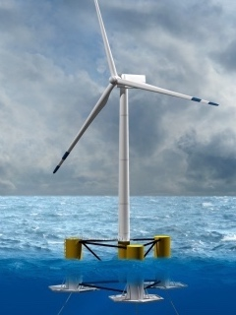
Some advanced optimization/mathematics techniques will be helpful
LCOE
Analytic gradients
Mixed-integer optimization
Adjoint methods
Multifidelity modeling
Uncertainty quantification
Optimization under uncertainty
Concepts that will be especially useful for floating applications include:
Uncertainty quantification
Uncertainty comes from inexact models, approximate data, and other sources
Need to put error bars on outputs
Optimization under uncertainty
How to make design choices that take into account uncertainty
Multifidelity modeling
Low-fidelity models may be useful for broad tradespace exploration but might miss some constraints because of complicated physics
Mixed-integer operation
Account for both continuous design parameters (e.g., hub height) and discrete parameters (e.g., number of mooring lines)
Notes:
For the other optimization wonks in audience, leverage a number of techniques popularized in recent years
Listed here, some to note
Uncertainty quant:
representation of physics approximate, cost data are best guesses
Optimization under uncertainty- make best choices in this environment
Multi-fidelity: low-fidelity models run quickly great for optimization, but might miss constraints revealed in more accurate engineering-fidelity or high-fidelity models. Use multi-fidelity to bring these others into early conceptual design avoid land-mines

Slide 11
NREL’s WISDEM framework with offshore engineering and cost additions
WISDEM: Wind-Plant Integrated System Design & Engineering Model
Substructure
Turbine Design
Floating Substructure
Turbine Performance
Dynamic Simulation
Turbine Structure
Tower
Rotor Substructure
Rotor Aerodynamics
Machine Aeroelastic Properties & Controls
Turbine Dynamics
Onshore foundation
Turbine Loads & Energy Performance
Plant Dynamics
Offshore Jacket
Drivetrain
Generator
Component Mass Properties, Materials & Geometry / Dimensions
Power, Thrust, Noise Curves
Specific Flow Plant Energy Output
Plant Cost
Modeling
Turbine Capital Costs
Offshore Balance of Station
Onshore Balance of Station
Annual Energy Production
Component Cost Models
Layout Design
Offshore Operational
Onshore Operational
Plant Layout and Energy Production
System Cost Analysis
Turbine Costs
Plant Costs
Financing
Energy Production

Slide 12
Workflow in FloatingSE, the WISDEM module for floating substructure conceptual design
FloatingSE
Aerodynamic loads
Geometry and material definition
Hydrostatic loads (Morison, Airy waves)
Static structural performance (pyFrame3DD)
Discretization
Output
Design Load Cases
Mooring system response (pyMAP)
Substructure outputs and constraints
User Input
API Standards (Bulletin 2U)

Slide 13
Outline
Motivation and Approach
Model Set-Up
Design Evaluation
Conceptual Design Optimization and Sensitivity Study
Conclusions
Model Set-Up

Slide 14
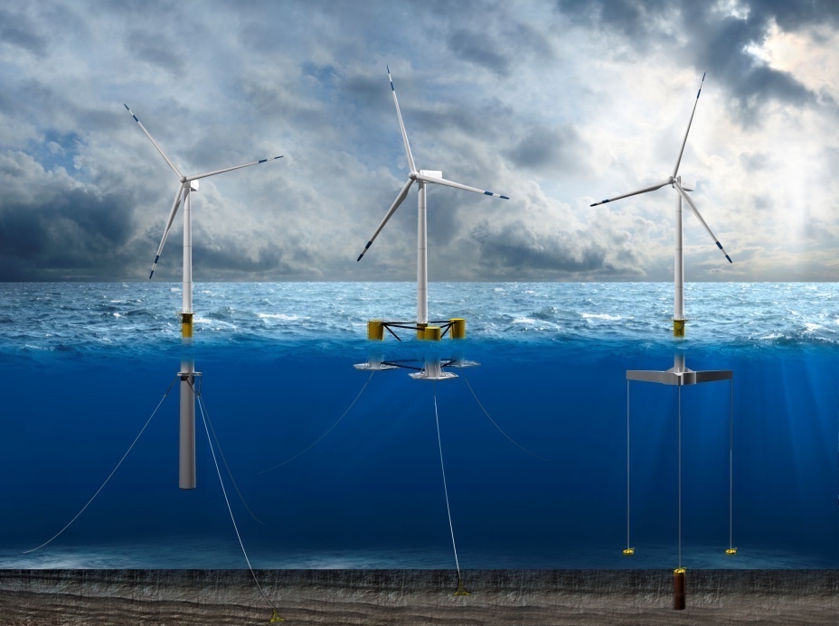
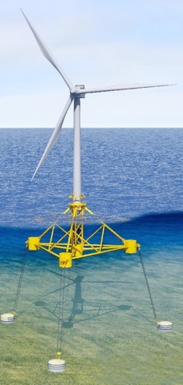
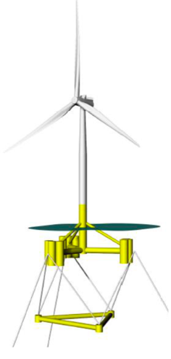
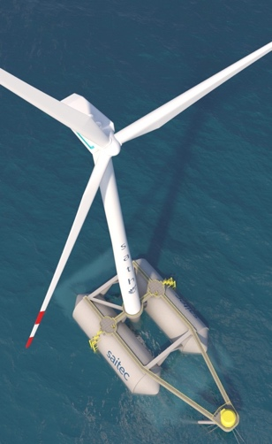
Geometry design in FloatingSE is intended to be generic enough to describe any geometry
Classic “Archetype” Designs
Innovative Designs
Stiesdal TetraSpar
Aerodyn
Engineering
SCD nezzy
SBM Offshore
saitec offshore
SATH
Semisubmersible
Tension leg platform
Spar
Illustration by Joshua Bauer, NREL
EOLink
Notes:
Let’s start with substructure
Everyone is familiar with 3 archetype designs: spar-buoy, semisubmersible, TLP
None perfect, each has pros and cons
Spar is great in terms of simplicity, low CG and decent performance but long drafts really limit use of ports and ability to tow it, so may mean assembly at sea
Semisubmersible has much shorter drafts, stable for towing, but can be heavier with more joints that fatigue and higher CG leading to more tower top motion
TLP has the best performance in terms of minimal motion, but can be complicated to install with highly tensioned mooring lines which are also more likely to break while in operation
TRANS: Luckily the industry has been working on solutions

Slide 15
Primary geometry parameterization
Modular approach enables rapid analysis of many of the designs currently being explored
Also allows optimization algorithm to fluidly search a broad tradespace
Rotor Diameter
Wind
0° direction
Diameter (at section nodes)
Hub Height
z
Wave
Freeboard
x
Mean Water Line
Ring Stiffeners
Fairlead
Draft
Current Profile
Section heights
Buoyancy tank
Buoyancy tank height, diameter, location
Water Depth
Ballast
Water
Permanent (variable density)
Mooring Line
Mooring Line Length (unstretched)
Permanent ballast height
Mooring Diameter
Mooring Line
Seafloor
Anchor radius
Notes:
`

Slide 16
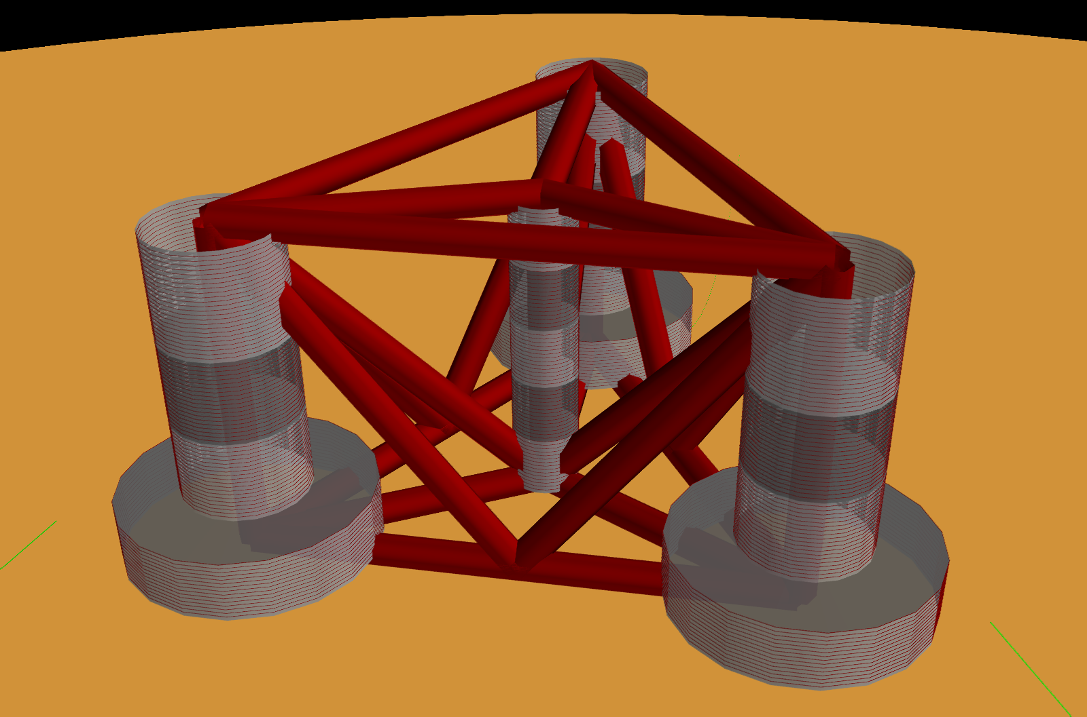
Pontoon/truss parameterization is also meant to be generic
Many substructure designs use pontoons that form a truss to connect different components
All pontoons are assumed to be made of the same material and have the same cross-section
Parameterization via discrete design variables
Upper and lower rings connecting the offset columns (B and D)
Upper and lower main-to-offset connections (A and C)
Lower-base to upper-offset cross members (E)
V-shaped cross members (F)
A
B
E
F
F
C
D

Slide 17
Cost estimation breaks down substructure into fundamental raw material and labor costs
Process-based cost model for substructure materials and manufacturing according to work of Farkas and Jarmai
Assume entire structure is made from steel that runs at $1.1/kg
Break down key labor operations and charge at $1/min
Cutting, Forming, Welding
Time required scales with type of cut/weld, length of cut/weld, and the masses of the pieces
Finishing and painting scale by surface area at $28/m²

Slide 18
Outline
Motivation and Approach
Model Set-Up
Design Evaluation
Conceptual Design Optimization and Sensitivity Study
Conclusions
Design Evaluation

Slide 19
Turbine load path is evaluated with beam FEM to generate optimization constraints via code checks
Loading Sources*
Rotor forces and moments
Wind loading
Frame3DD
Quasi 1-D static beam finite element analysis
Euro & API code checks
Gravity
Member stresses
Airy (linear) waves
Morrison’s Equation
Hydrostatics
Mooring tension
(computed by MAP++)
Optimization constraints
*DLC Assumption:
Only maximum rotor thrust and wind-wave load case considered

Slide 20
There are multiple checks for system stability
Pitch Stability
Mooring + Hydrostatic restoring moment >
Rotor moment + Aero-Hydro pitch
Neutral Stability
Hydrostatic pressure in z-direction (buoyancy) =
Gravity* + Mooring tension
* Adjustable with water ballast
Surge Stability
Mooring restoring force >
Rotor thrust + Aero-Hydro surge
Buoyant force
M
M
G
𝜑
G
GZ (righting arm)
B’
Buoyant force
Hydrodynamic Stability
Highest wave freq <
Rigid Body Freqs <
Lowest wave freq
CL
B’
Gravity force

Slide 21
Outline
Motivation and Approach
Model Set-Up
Design Evaluation
Conceptual Design Optimization and Sensitivity Study
Conclusions
Conceptual Design Optimization and Sensitivity Study

Slide 22
Nacelle mass sensitivity study: Vary substructure, mass/cost objective, mass perturbation
DTU 10MW RNA
DTU 10MW RNA
DTU 10MW RNA
(blank slate substructure)
Global
Optimization
(genetic algorithm)
Conceptual Design
Local
Optimization
(simplex / subplex)
Baseline Design
Local
Optimization
“Tabula rasa” (blank slate) global optimization using GA
No initial feasible point
Mixed-integer optimization (continuous and discrete design variables)
Constraints enforced via penalty
Local optimization using Nelder-Mead simplex algorithm
Continuous variables only
Constraints enforced via penalty
2 Objectives
3 Archetypes
Repeat
Spar
Mass
Cost
Semi
Mass
Cost
TLP
Mass
Cost
+10%
-33%
-10%
-50%
-25%

Slide 23
Caveats and limitations
“Optimized Designs” means optimization algorithm convergence only
Would not outperform other designs or be considered ready for manufacturing
Considered hydrostatic loading only
Dynamic loads not accounted for
Using a single DLC: maximum thrust condition
Other drivers (e.g. mooring line snap) are not considered
Simple quasi-static 1-D beam finite element and mooring analysis
Simplified cost and manufacturing process model
No assembly, installation, operations, or maintenance costs were captured
TLP looks like lowest cost option
Break-even cost points will change after other costs are considered
The incomplete incorporation of existing codes and standards

Slide 24
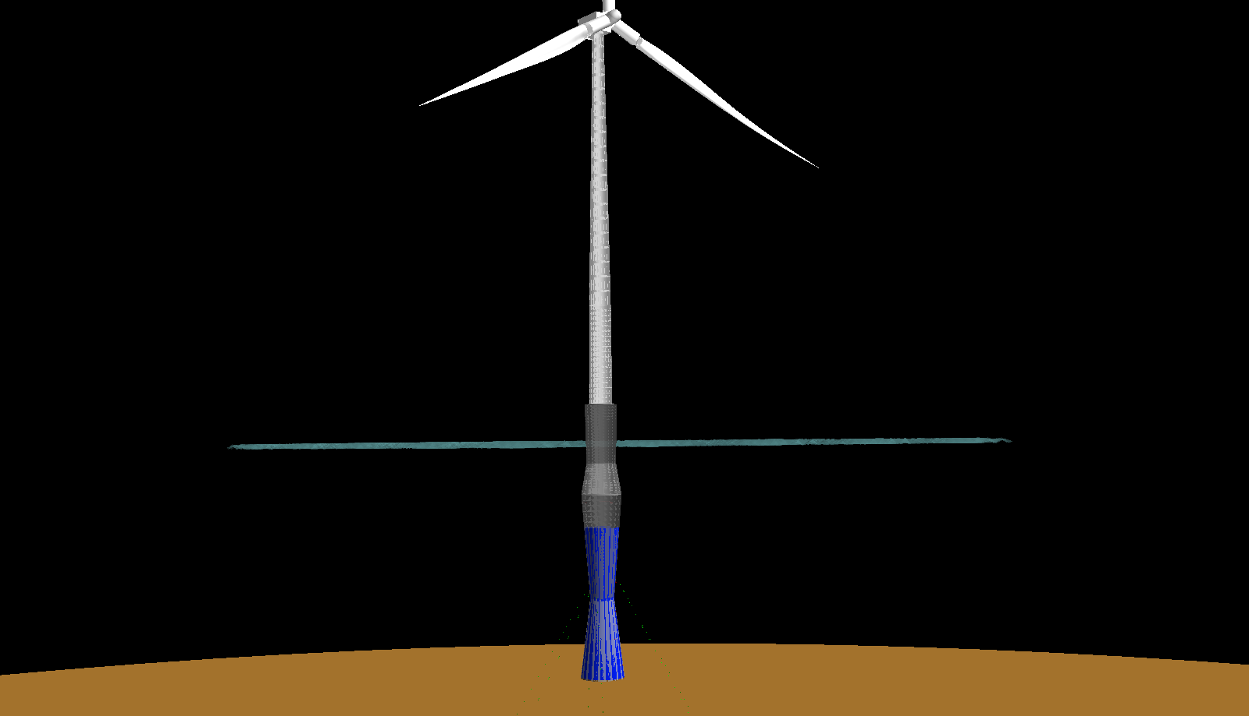
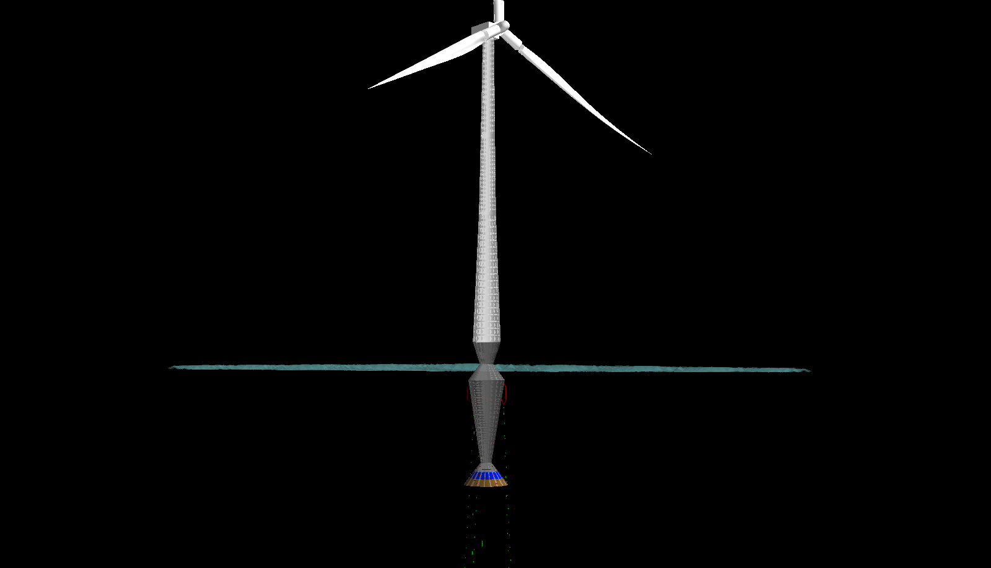
Spar Optimization
Spar optimization minimizes mass/cost while maintaining hydrostatic stability
Tapers diameter near the waterline to reduce wave loads
Mass optimized design favors water ballast over permanent ballast and longer draft over ballast
Standard catenary moorings
Cost optimized design favors permanent ballast over longer drafts and minimal column diameter whenever possible
Nearly semi-taut mooring lines
Mass-optimized design
Cost-optimized design

Slide 25
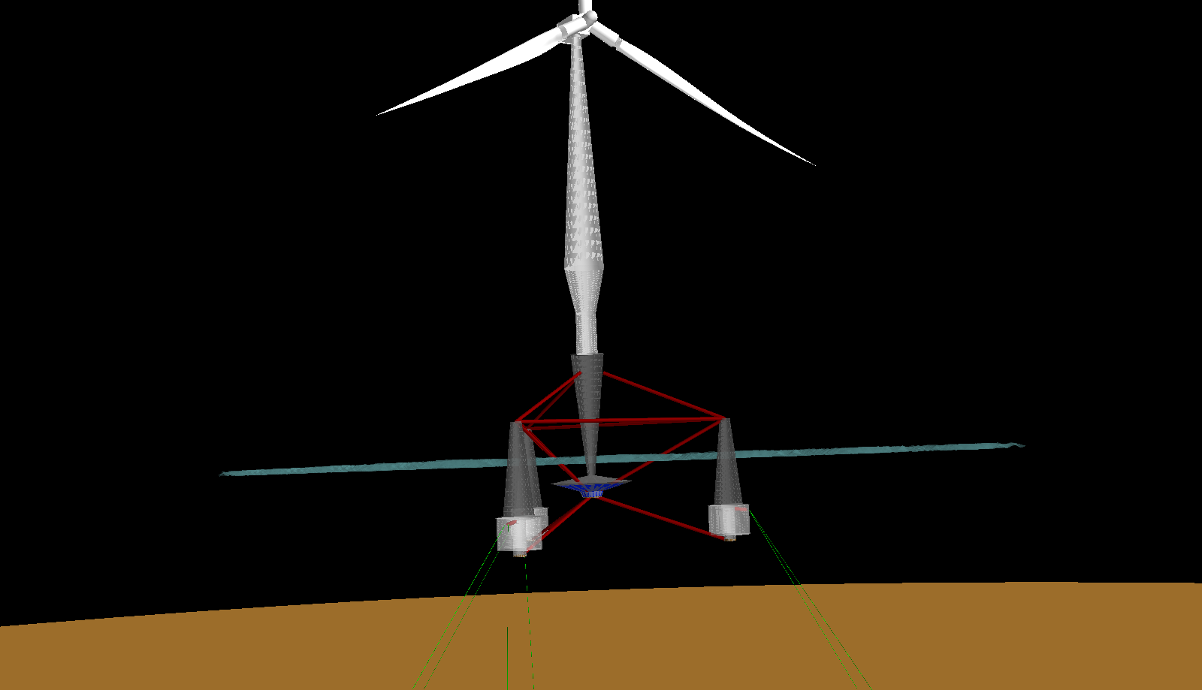
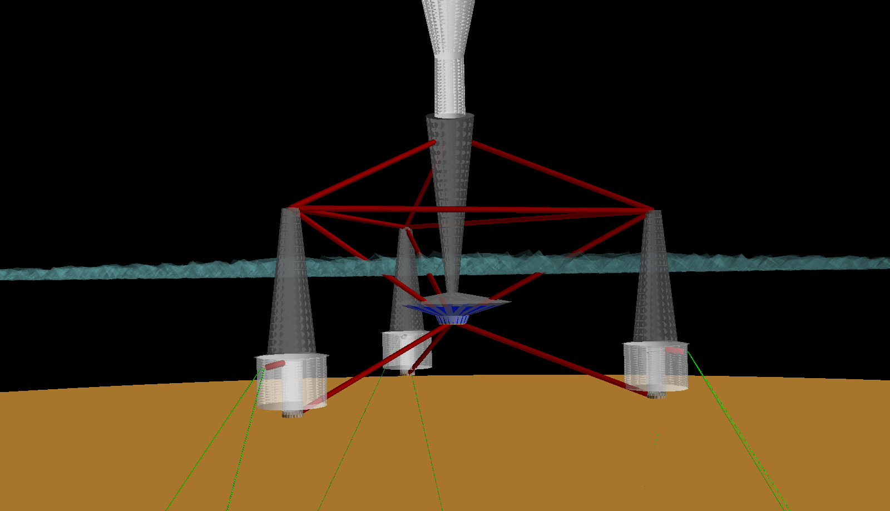
Semi Optimization
Optimized (cost or mass) design
Optimized (cost or mass) design
Semisubmersible optimization looks similar for both mass and cost objectives
Minimal central column (mostly just water ballast holding tank)
Tapered offset columns with buoyancy tanks
Two mooring lines per offset column

Slide 26
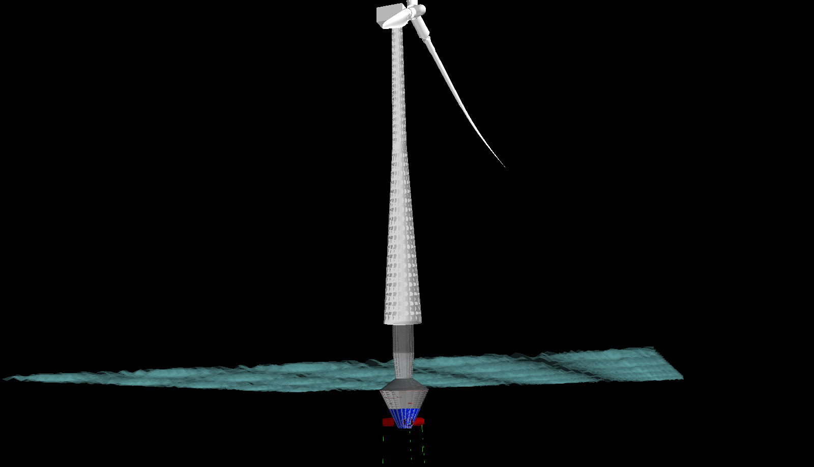
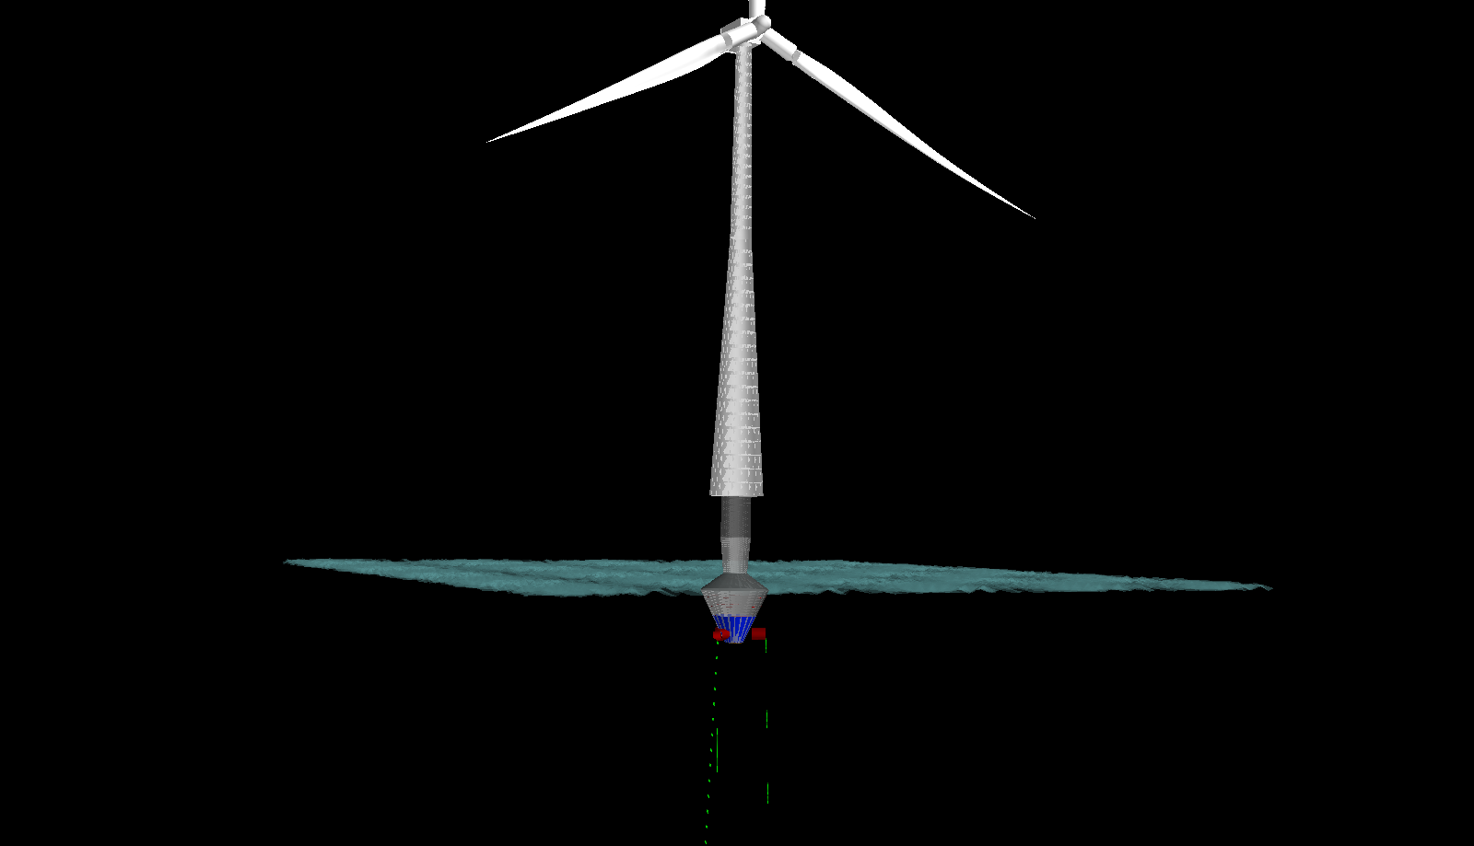
TLP Optimization
Optimized (cost or mass) design
Optimized (cost or mass) design
TLP optimization looks similar for both mass and cost objectives
Tapers diameter near the waterline to reduce wave loads
Three legs that support two taut, synthetic mooring lines each

Slide 27
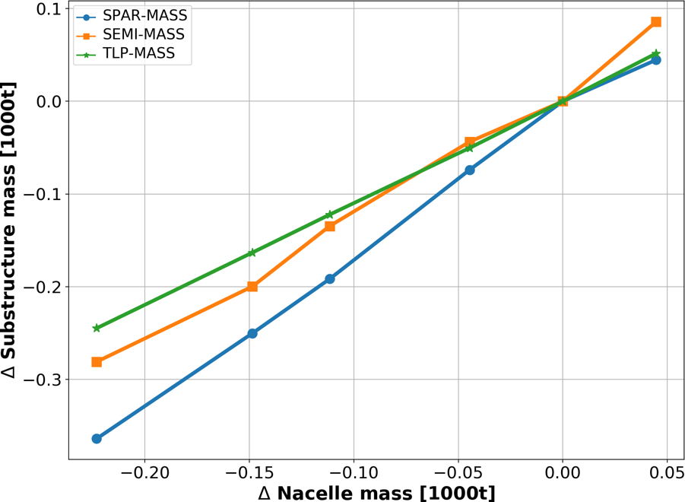
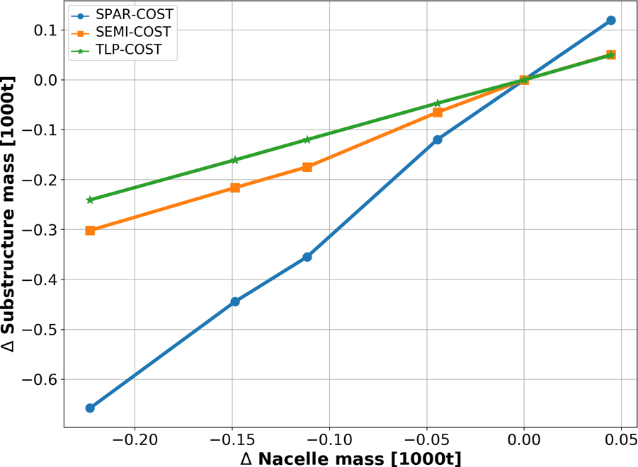
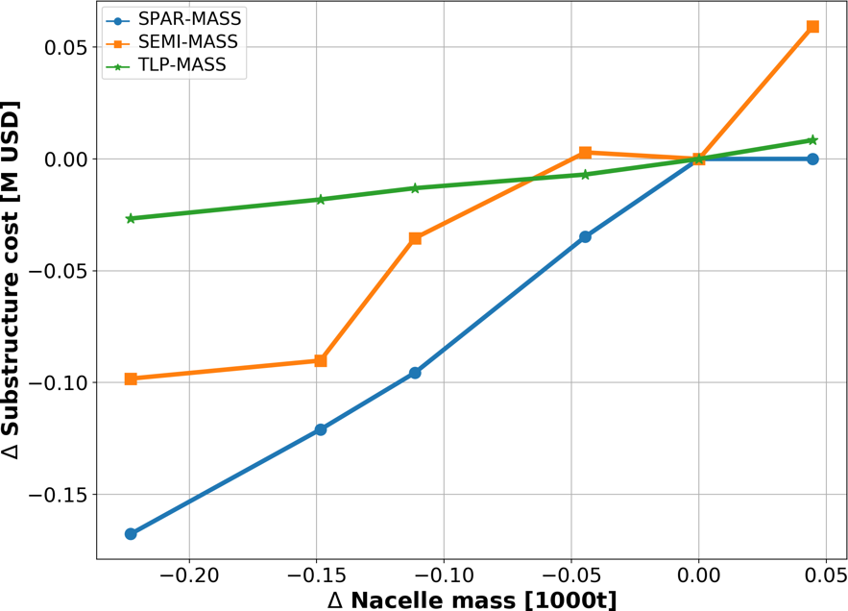
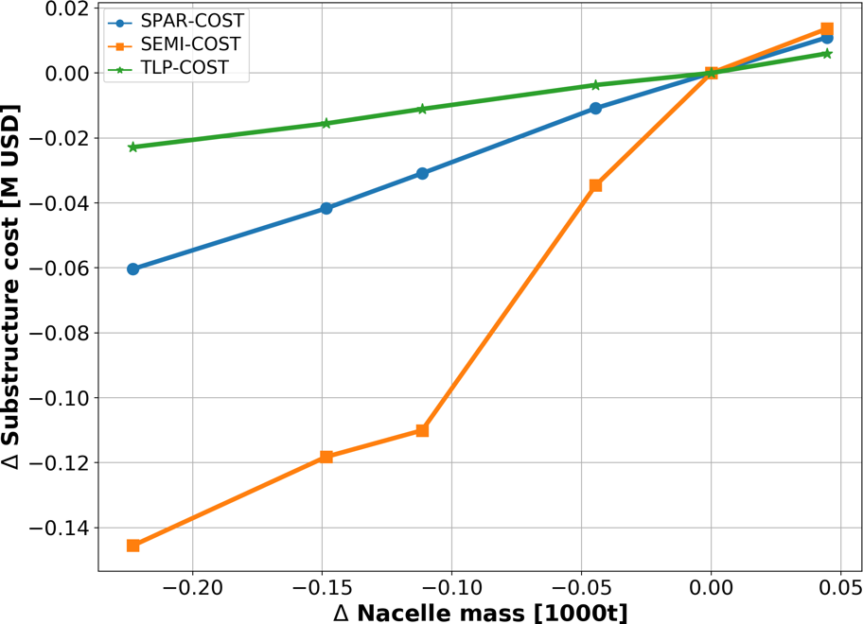
With the framework in place, can explore cost-benefit tradeoffs and design sensitivities
To simulate the introduction of a novel drivetrain technology, nacelle mass was parametrically changed and the design re-optimized
Design sensitivities for optimizations of mass vs. cost are quite different and lead to interesting conclusions
 | Mass Optimized | Cost Optimized
Mass Sensitivity
Cost Sensitivity
Mass consistently decreases even though cost is objective
Mass of structure decreases as mass is removed from nacelle
Has not fully converged
By focusing on heaviest ingredients instead of costliest, the cost can increase
Cost of structure decreases as mass is removed from nacelle

Slide 28
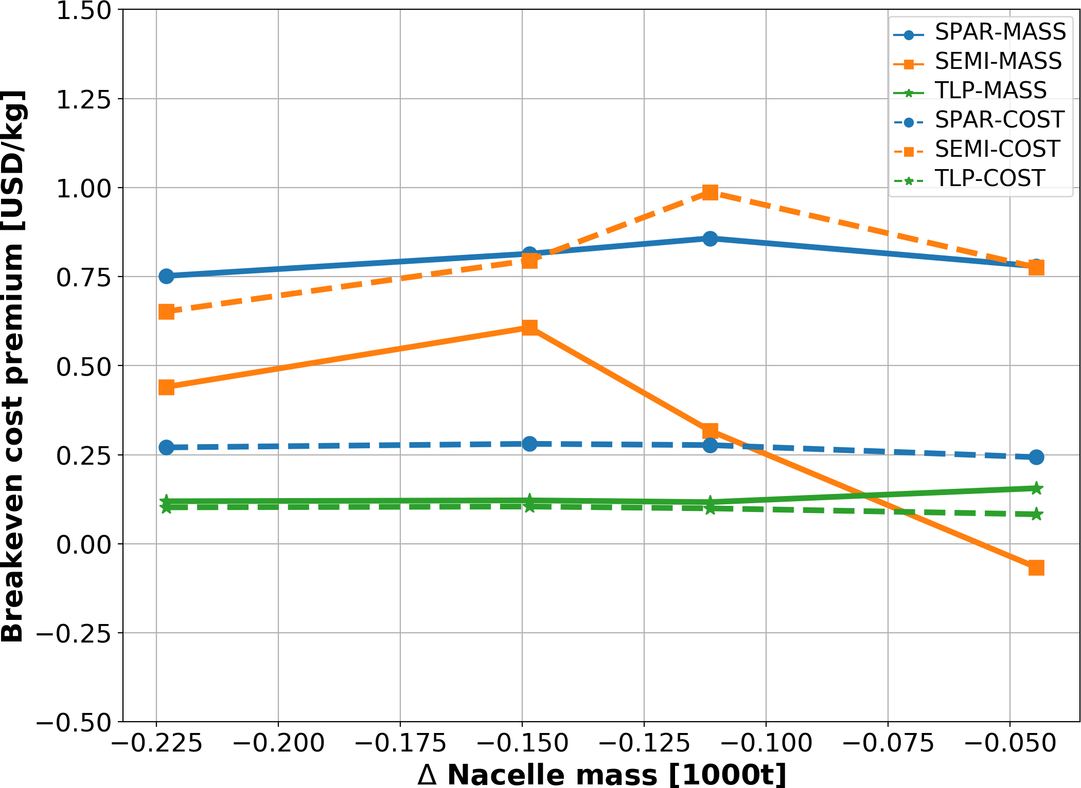
We can determine the breakeven cost premium of the generic new nacelle technology over the old technology
We know the mass parametrically removed from the nacelle
Perhaps a new technology offering cost savings at a premium
We also know the cost removed from the tower and substructure
We can take the ratio to determine the breakeven premium cost rate over the old technology
New technology PREMIUM would be a net cost ADDITION to the system
New technology PREMIUM would be a net cost REDUCTION to the system

Slide 29
Conclusions
WISDEM can now simulate a full floating offshore wind turbine with FloatingSE and uses a generic geometry parameterization to describe many types of substructures
Potential of the model is demonstrated by the nacelle-weight sensitivity study
Break-even cost premium for the more expensive, but lighter-weight technology:
Spar: $0.25-0.75/kg Semi: $0.75-1.00/kg TLP: $0.1/kg
Estimated break-even costs are likely too low because there was no accounting for impacts on assembly and installation equipment or the likely scaling to a higher rated turbine with greater energy capture and lower LCOE
Mass is poor surrogate for cost in global optimization studies due to differences in cost rates and/or complexity in cost models
Underscores the need for a cost-focused multidisciplinary systems framework for floating offshore wind
Many caveats means there is plenty of room for improvement and the key findings could change
Accounting for hydrodynamics and additional load cases
Coupling to a detailed cost model of the balance of station and operational costs

Slide 30
Parking Lot

Slide 31
Column ring stiffener geometry parameterization
Wall thickness
Radius
Flange thickness
Web height
Stiffener spacing
Flange width
Web thickness

Slide 32
Weight sensitivity study metocean inputs and mass perturbations
Perturbation | Nacelle Mass
Nominal | 446,036 kg
+10% | 490,640 kg
-10% | 401,433 kg
+25% | 334,527 kg
+33% | 297,506 kg
+50% | 223,018 kg
Metocean | Value
Wind speed | 11 m/s
Ref height | 119 m
Water depth | 320 m
Sig wave height | 10.8 m
Sig wave period | 9.8 sec

Slide 33
Design variables for tower and substructure design
Design Variable | Bounds |  | Design Variable | Bounds
Main col section height | 0.1--50 m |  | Main col buoyancy tank height | 0--20 m
Main col outer diameter | 2.1--40 m |  | Main col buoyancy tank location (fraction) | 0--1
Main col wall thickness | 0.001--0.5 m |  | Fairlead (fraction) | 0--1
Main col freeboard | 0--50 m |  | Fairlead offset from col (TLP only) | 5--30 m
Main col stiffener web height | 0.01--1 m |  | Fairlead pontoon diameter | 0.1--10 m
Main col stiffener web thickness | 0.001--0.5 m |  | Fairlead pontoon wall thickness | 0.001--1 m
Main col stiffener flange width | 0.01--5 m |  | Number of mooring connections | 3--5
Main col stiffener flange thickness | 0.001--0.5 m |  | Mooring lines per connection | 1--3
Main col stiffener spacing | 0.1--100 m |  | Mooring diameter | 0.05--2 m
Main col permanent ballast height | 0.1--50 m |  | Mooring line length | 0--3000 m (TLP 10-300)
Main col buoyancy tank diameter | 0--50 m |  | Anchor distance | 0--5000 m TLP (20-100)
Main col section height | 0.1--50 m |  | Main col buoyancy tank height | 0--20 m
Main col outer diameter | 2.1--40 m |  | Main col buoyancy tank location (fraction) | 0--1
Main col wall thickness | 0.001--0.5 m |  | Fairlead (fraction) | 0--1
Main col freeboard | 0--50 m |  | Fairlead offset from col (TLP only) | 5--30 m
Main col stiffener web height | 0.01--1 m |  | Fairlead pontoon diameter | 0.1--10 m
Main col stiffener web thickness | 0.001--0.5 m |  | Fairlead pontoon wall thickness | 0.001--1 m
Main col stiffener flange width | 0.01--5 m |  | Number of mooring connections | 3--5
Main col stiffener flange thickness | 0.001--0.5 m |  | Mooring lines per connection | 1--3
Main col stiffener spacing | 0.1--100 m |  | Mooring diameter | 0.05--2 m

Slide 34
Additional design variables for the semisubmersible only
Design Variable | Bounds |  | Design Variable | Bounds
Number of offset cols | 3--5 |  | Offset col buoyancy tank height | 0--20 m
Radius to offset col | 5--100 m |  | Offset col buoyancy tank location (fraction) | 0--1
Offset col section height | 0.1--50 m |  | Pontoon outer diameter | 0.1--10 m
Offset col outer diameter | 1.1--40 m |  | Pontoon wall thickness | 0.01--1 m
Offset col wall thickness | 0.001--0.5 m |  | Lower main-offset pontoons | 0--1
Offset col freeboard | 2--15 m |  | Upper main-offset pontoons | 0--1
Offset col stiffener web height | 0.01--1 m |  | Cross main-offset pontoons | 0--1
Offset col stiffener web thickness | 0.001--0.5 m |  | Lower offset ring pontoons | 0--1
Offset col stiffener flange width | 0.01--5 m |  | Upper offset ring pontoons | 0--1
Offset col stiffener flange thickness | 0.001--0.5 m |  | Outer V-pontoons | 0--1
Offset col stiffener spacing | 0.01--100 m |  | Main col pontoon attach lower (fraction) | 0--0.5
Offset col permanent ballast height | 0.1--50 m |  | Main col pontoon attach upper (fraction) | 0.5--1
Offset col buoyancy tank diameter | 0--50 m
Number of offset cols | 3--5 |  | Offset col buoyancy tank height | 0--20 m
Radius to offset col | 5--100 m |  | Offset col buoyancy tank location (fraction) | 0--1
Offset col section height | 0.1--50 m |  | Pontoon outer diameter | 0.1--10 m
Offset col outer diameter | 1.1--40 m |  | Pontoon wall thickness | 0.01--1 m
Offset col wall thickness | 0.001--0.5 m |  | Lower main-offset pontoons | 0--1
Offset col freeboard | 2--15 m |  | Upper main-offset pontoons | 0--1
Offset col stiffener web height | 0.01--1 m |  | Cross main-offset pontoons | 0--1

Slide 35
Constraints for Tower-Substructure optimization
Lower | Name | Upper |  | Lower | Name | Upper
 | Tower / Main / Offset Columns |  |  |  | Pontoons Only
 | Eurocode global buckling | 1 |  |  | Eurocode stress limit | 1
 | Eurocode shell buckling | 1 |  |  | Tower Only
 | Eurocode stress limit | 1 |  | -0.01 | Hub height error | 0.01
 | Manufacturability | 0.5 |  |  | Mooring
120 | Weld-ability |  |  | 0 | Axial stress limit | 1
 | Main / Offset Columns Only |  |  |  | Line length limit | 1
 | Draft ratio | 1 |  |  | Heel moment ratio | 1
 | API 2U general buckling- axial loads | 1 |  |  | Surge force ratio | 1
 | API 2U local buckling- axial loads | 1 |  |  | Geometry
 | API 2U general buckling- external loads | 1 |  | 1 | Main-offset spacing
 | API 2U local buckling- external loads | 1 |  | 0 | Fairlead:draft ratio | 1
 | Wave height:freeboard ratio | 1 |  | 0 | Nacelle transition buffer
1 | Stiffener flange compactness |  |  | -1 | Tower transition buffer | 1
1 | Stiffener web compactness |  |  |  | Stability
 | Stiffener flange spacing ratio | 1 |  | 0.1 | Metacentric height
 | Stiffener radius ratio | 0.5 |  | 1 | Wave-Eigenmode boundary (upper)
 | Offset Columns Only |  |  |  | Wave-Eigenmode boundary (lower) | 1
0 | Heel freeboard margin |  |  | 0 | Water ballast height limit | 1
0 | Heel draft margin |  |  | 0 | Water ballast mass

Slide 36
Baseline (optimized) designs
Substructure | Spar |  | Semisubmersible |  | TLP
Metric | Mass | Cost | Mass | Cost | Mass | Cost
Substructure mass [1000t] | 4 | 5.1 | 13.7 | 13.5 | 2 | 2
Substructure cost [M USD] | 10.8 | 7.2 | 34.7 | 34.5 | 6.3 | 6.3
Substructure displacement [k$m^3$] | 9.1 | 5.3 | 7.4 | 7.2 | 2.5 | 2.5
Substructure main ballast mass [t] | 346.8 | 3016.6 | 49.7 | 38.9 | 8.9 | 8.7
Substructure main col mass [1000t] | 2.5 | 3.7 | 0.8 | 0.8 | 0.6 | 0.6
Substructure offset col mass [1000t] | NA | NA | 1.1 | 1 | NA | NA
Substructure main col costs [M USD] | 6.3 | 2.7 | 2.3 | 2.3 | 1.9 | 1.9
Substructure offset col costs [M USD] | NA | NA | 2.9 | 2.8 | NA | NA
Substructure water ballast [1000t] | 5.4 | 0.3 | 0.7 | 0.6 | 0.5 | 0.5
Main column draft [m] | 82.2 | 50.3 | 12.6 | 12.6 | 19.1 | 19
Offset column draft [m] | NA | NA | 28.8 | 28.8 | NA | NA
Main column ave diameter [m] | 11.7 | 10.6 | 7.7 | 8.2 | 10 | 10
Offset column ave diameter [m] | NA | NA | 6.2 | 6.1 | NA | NA
Main column ave thickness [mm] | 64.1 | 27.9 | 56.4 | 55.9 | 43 | 42.8
Offset column ave thickness [mm] | NA | NA | 43.1 | 40.9 | NA | NA

Slide 37
What’s changing?

